Slide 1
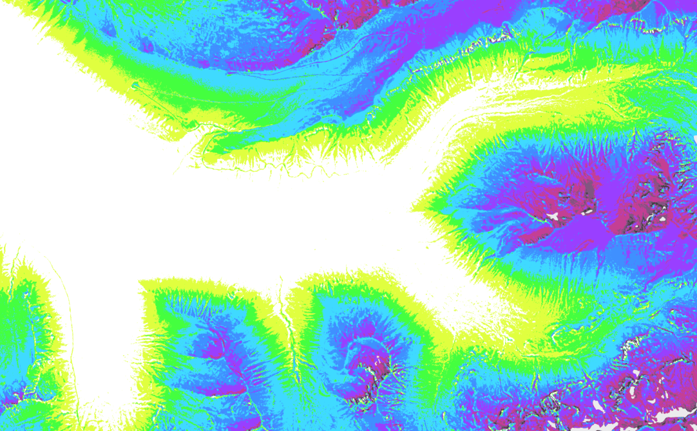
RMBL Spatial Data Science Webinar Series
Webinar 3: Successful UAV Data Collection in Mountain Environments
Ian Breckheimer, PhD
RMBL Staff Research Scientist
@ibreckhe | ikb@rmbl.org

Slide 2
Webinar Schedule
RMBL Spatial Data Science Webinar Series

Slide 3
Outline
Why?
What?
How?
Why drones, why now?
What foundational concepts do I need to know to collect good drone data?
What changes are coming for drones in the near future?
What are common pitfalls of drone data, and how can I avoid them?
How to use R and Litchi to design robust drone data collection.

Slide 4
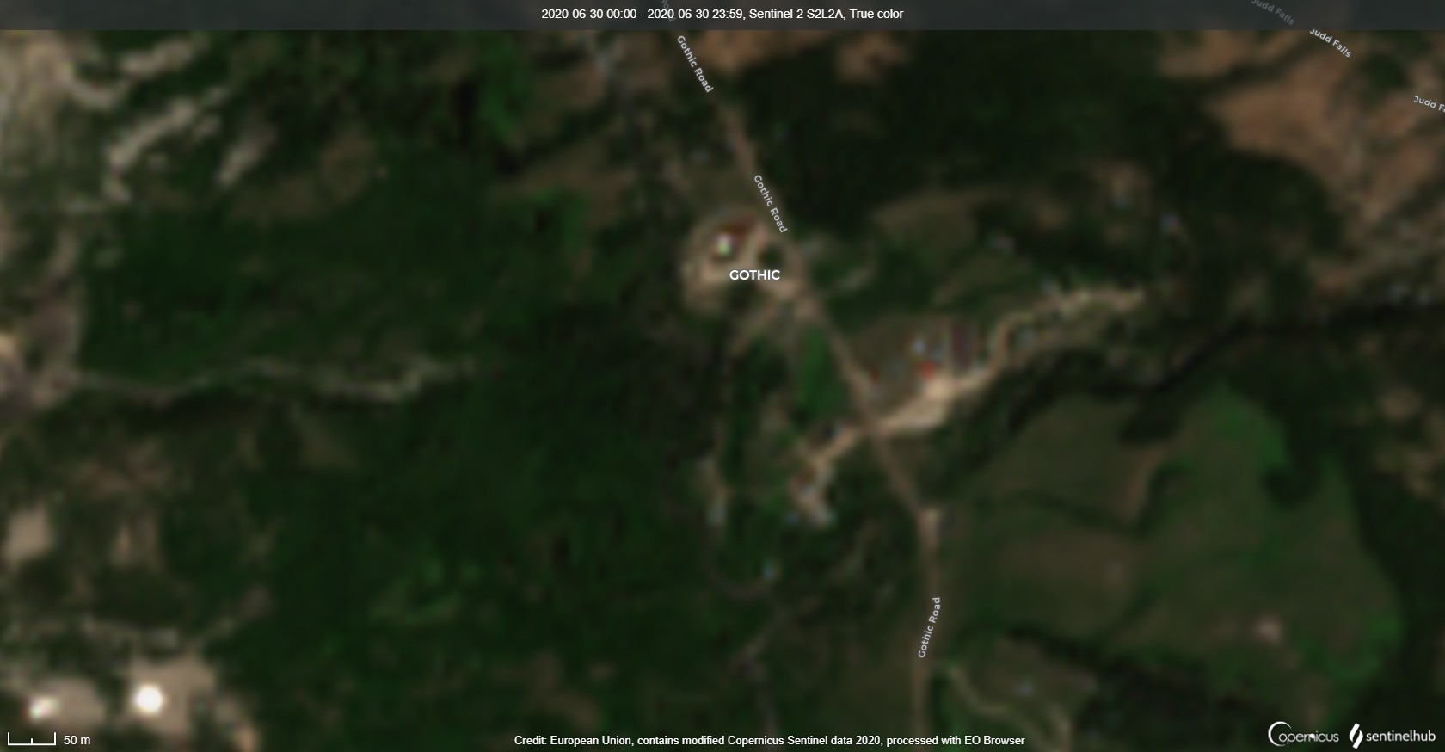
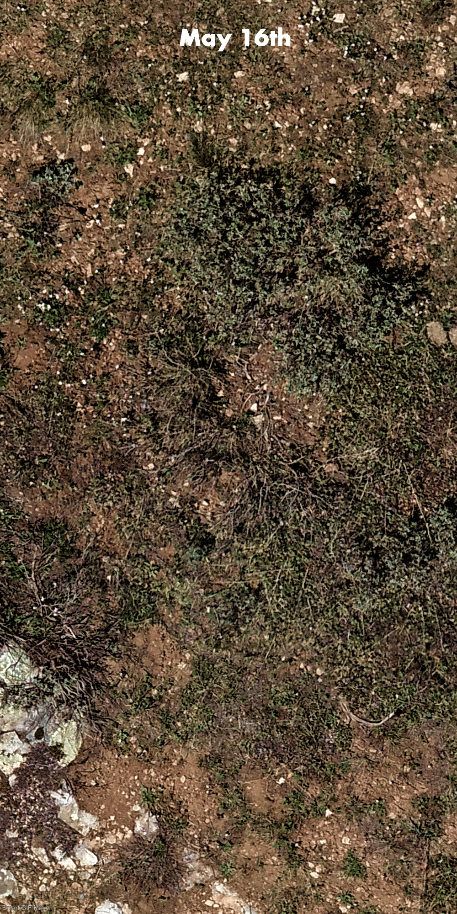
Why Drones, Why Now?
Notes:
In 2000 – 15 Major EO satellite platforms, 2010 – 43 platforms, 2020 – 80+

Slide 5
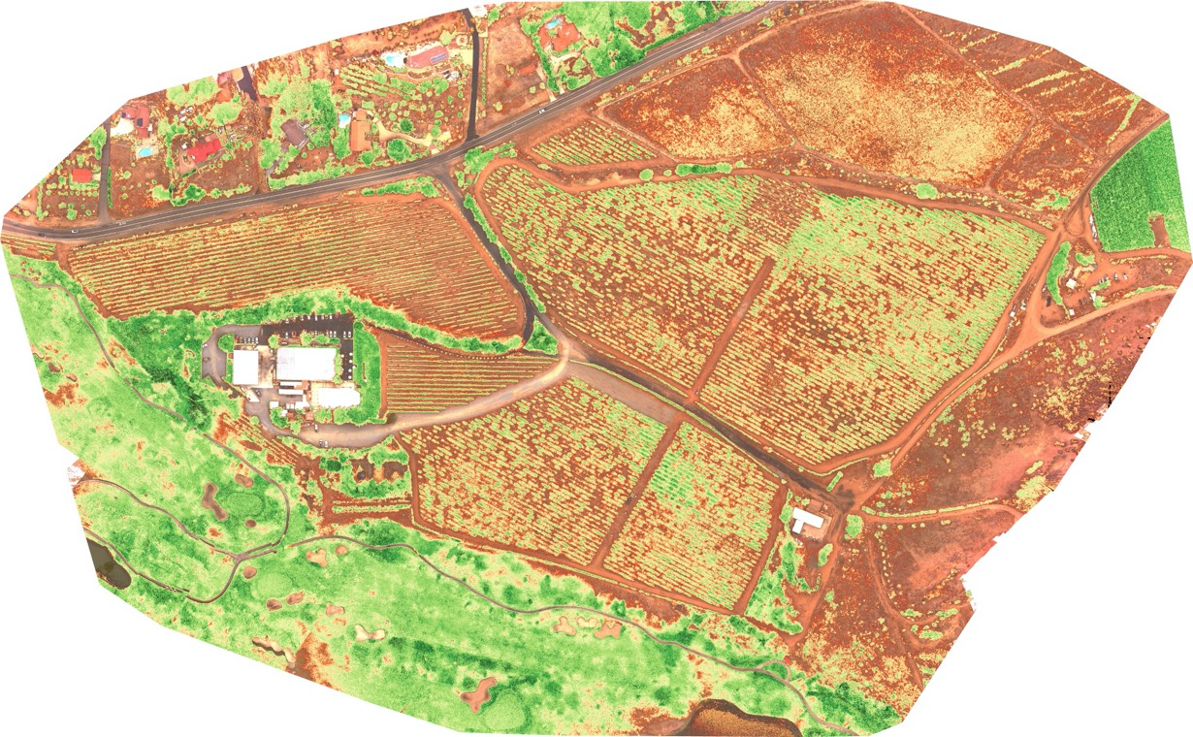
2D: plant health / cover / stress
Image: MapIR

Slide 6
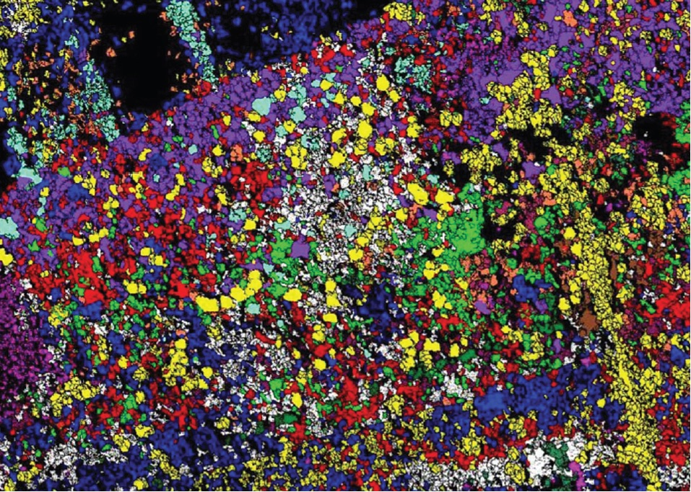
2D: hyperspectral measurements
Image: Asner et al. 2015

Slide 7
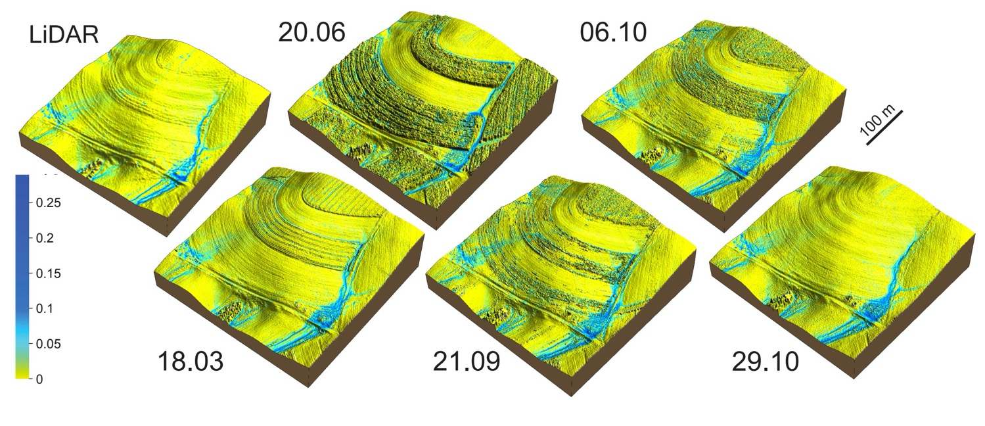
3D: terrain / flow models
Figure: Petrasova et al. 2017

Slide 8
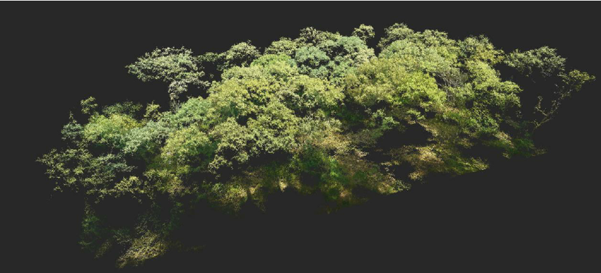
3D: vegetation structure
Figure: Sperlich et al. 2014

Slide 9
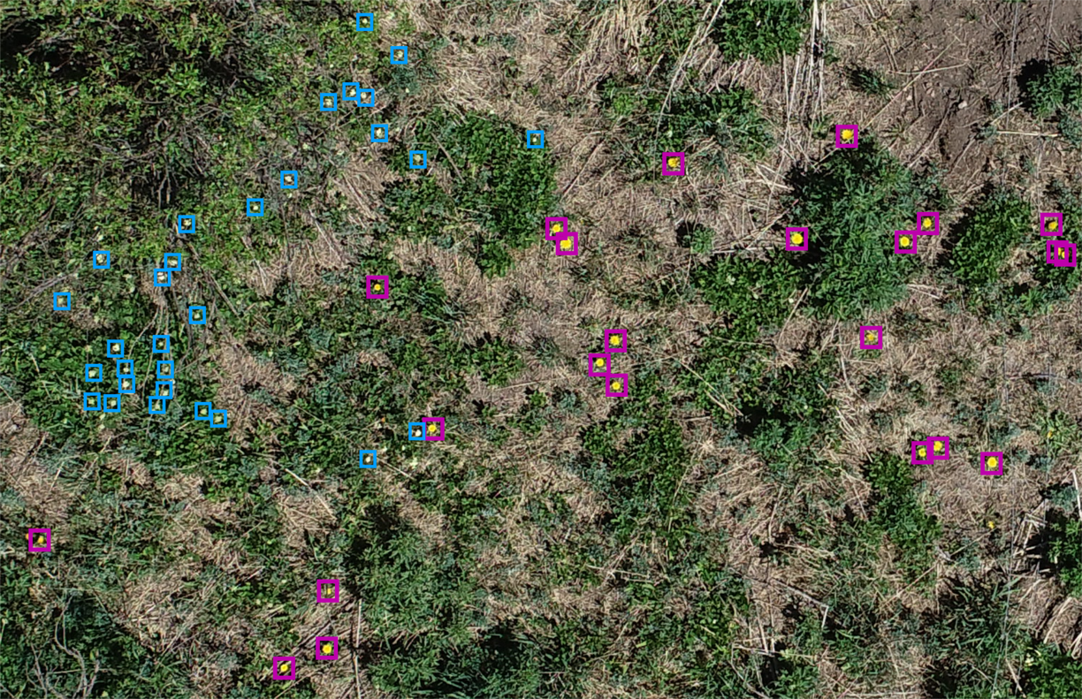
2D/3D: object detection

Slide 10
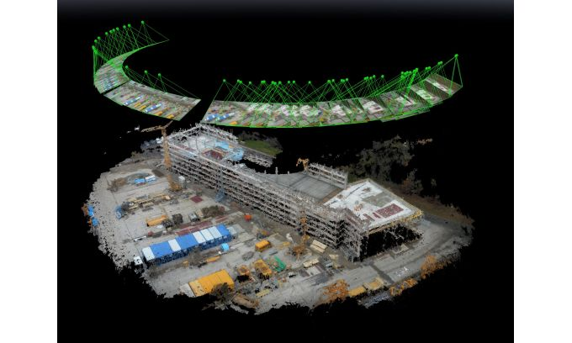
Integrated sensing and analytics
Surveying and Inspection
Precision agriculture
Images: GIM International, Gamaya

Slide 11
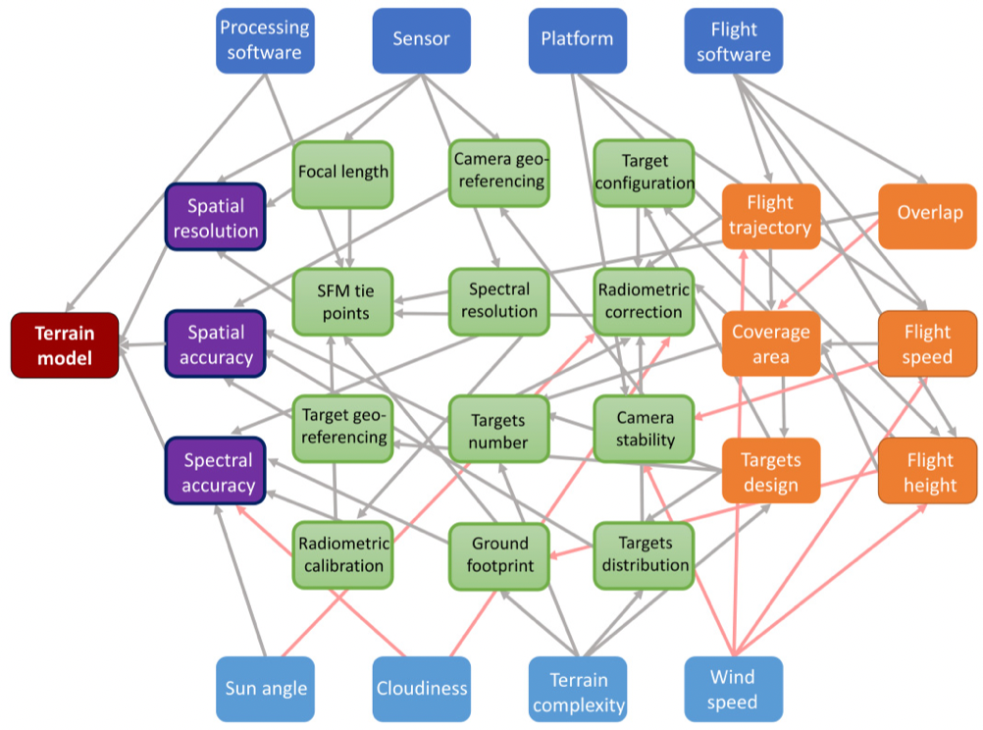
The challenge with drone data:
Figure: Tmušic et a. 2020

Slide 12
Outline
Why?
What?
How?
Why drones, why now?
What foundational concepts do I need to know to collect good drone data?
What changes are coming for drones in the near future?
What are common pitfalls of drone data, and how can I avoid them?
How to use R and Litchi to design robust drone data collection.

Slide 13
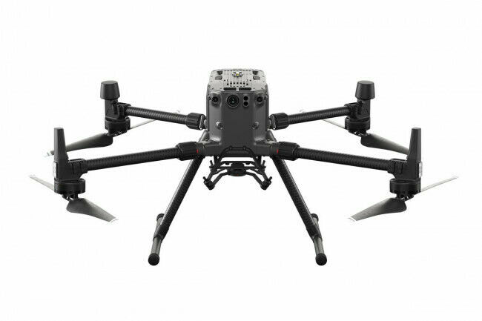
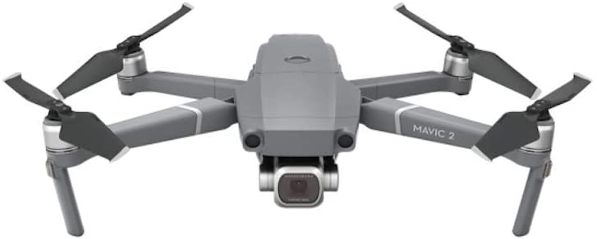
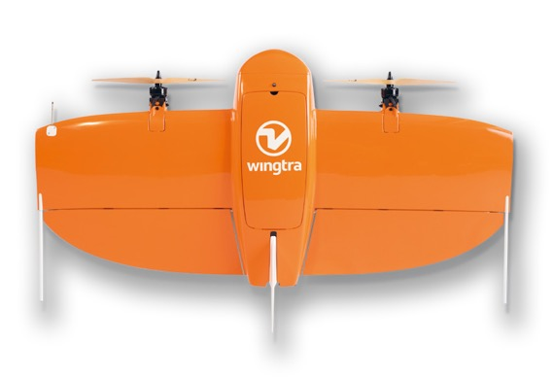
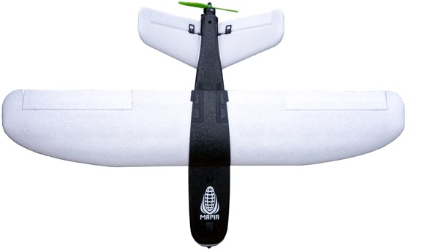
Drone platform fundamentals:
Multicopters: Stable, maneuverable, VTOL, slow
Fixed wing: Fast, long-ranging, less stable.
Images: DJI, MapIR, Wingtra

Slide 14
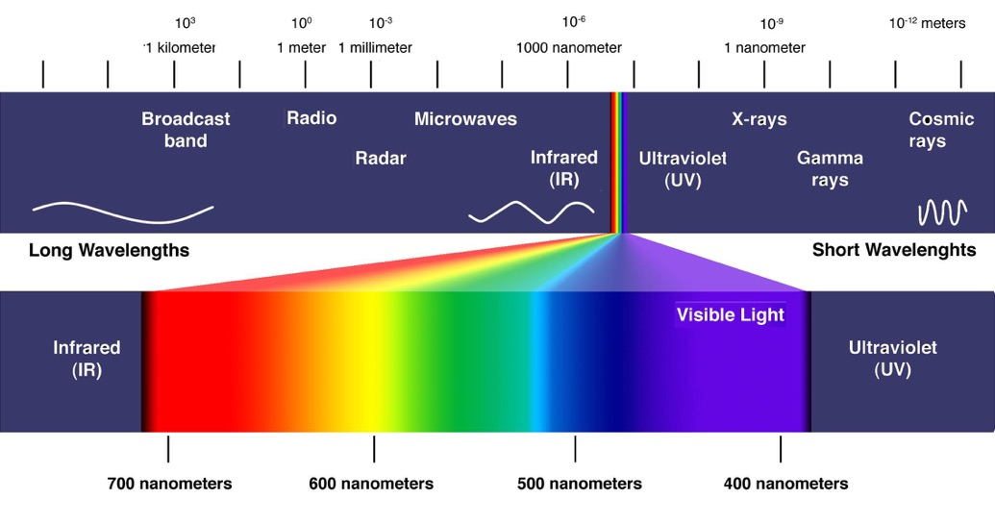
Drone sensor fundamentals:
Where most of the action is:
Image: ColorMatters

Slide 15
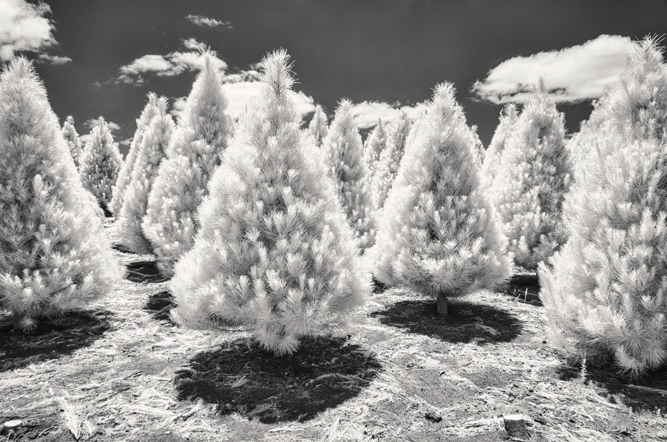
Drone sensor fundamentals:
Visible – IR cameras: Multispectral sensors
Image: Lisa Kimmorly

Slide 16
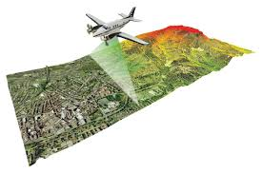
Drone sensor fundamentals:
Active sensors: LiDAR, Synthetic Aperture Radar
Image: PBOnline

Slide 17
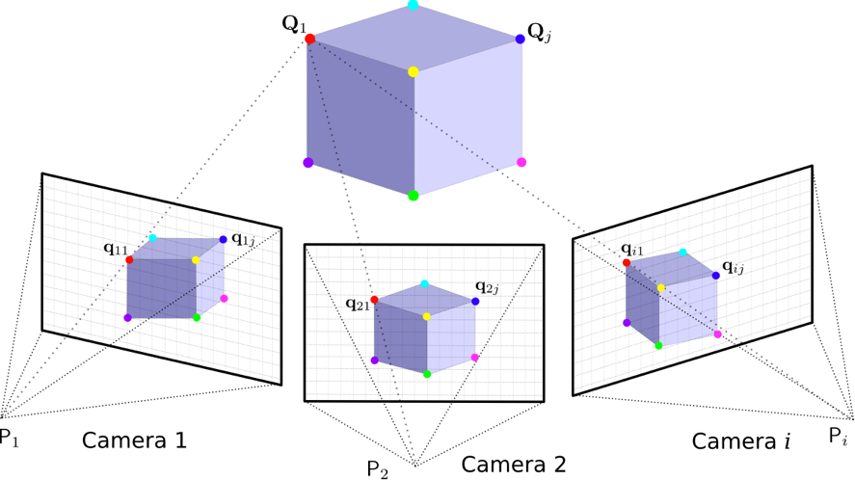
Data processing fundamentals
Structure-from-Motion – reconstructing 3D scenes from 2d images.
Image: Hypraptive

Slide 18
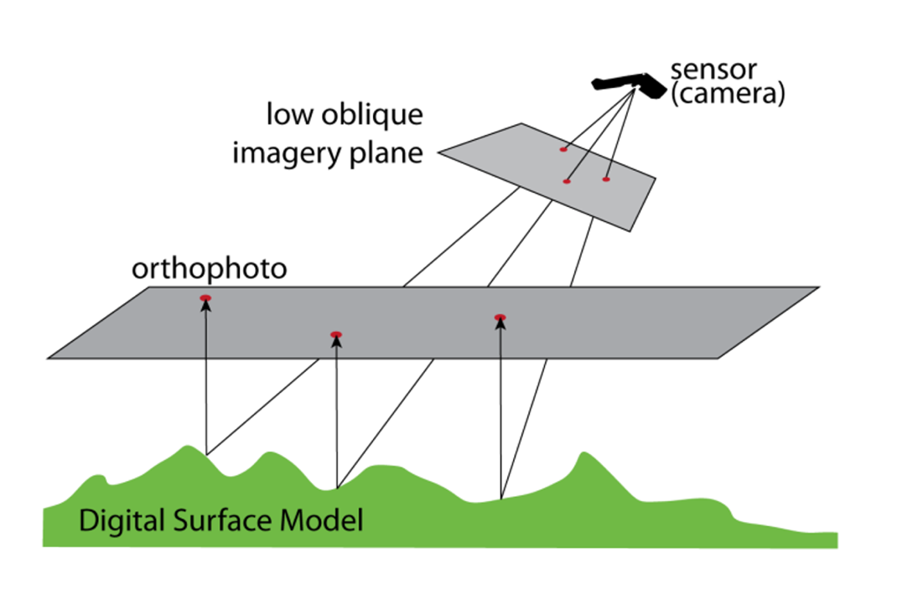
Data processing fundamentals:
Orthorectification – “undistorting” photos to get a top-down view

Slide 19
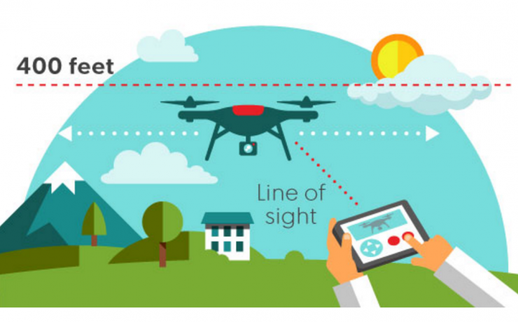
Drone regulation fundamentals:
Airspace regulated by The Man (the FAA in the USA).
Flying for research is considered commercial use and requires remote pilot certification.
Flights are restricted to certain conditions.
FAA Part 107
Image: NoFilmSchool

Slide 20
Outline
Why?
What?
How?
Why drones, why now?
What foundational concepts do I need to know to collect good drone data?
What changes are coming for drones in the near future?
What are common pitfalls of drone data, and how can I avoid them?
How to use R and Litchi to design robust drone data collection.

Slide 21
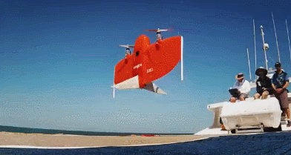
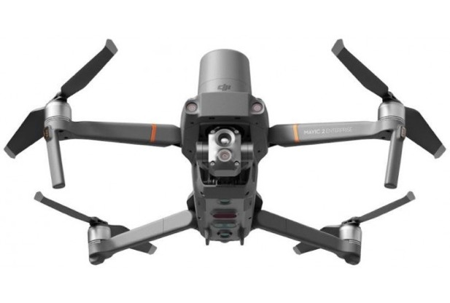
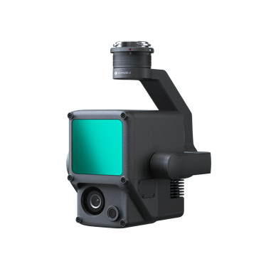
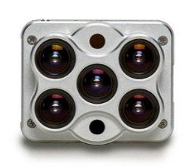
What new tech is coming?
Hybrid fixed wing designs.
Integrated sensor packages.
Cheap(er) high-precision GPS.
Companies to watch: SkyFish, Black Swift, Vantage Robotics

Slide 22
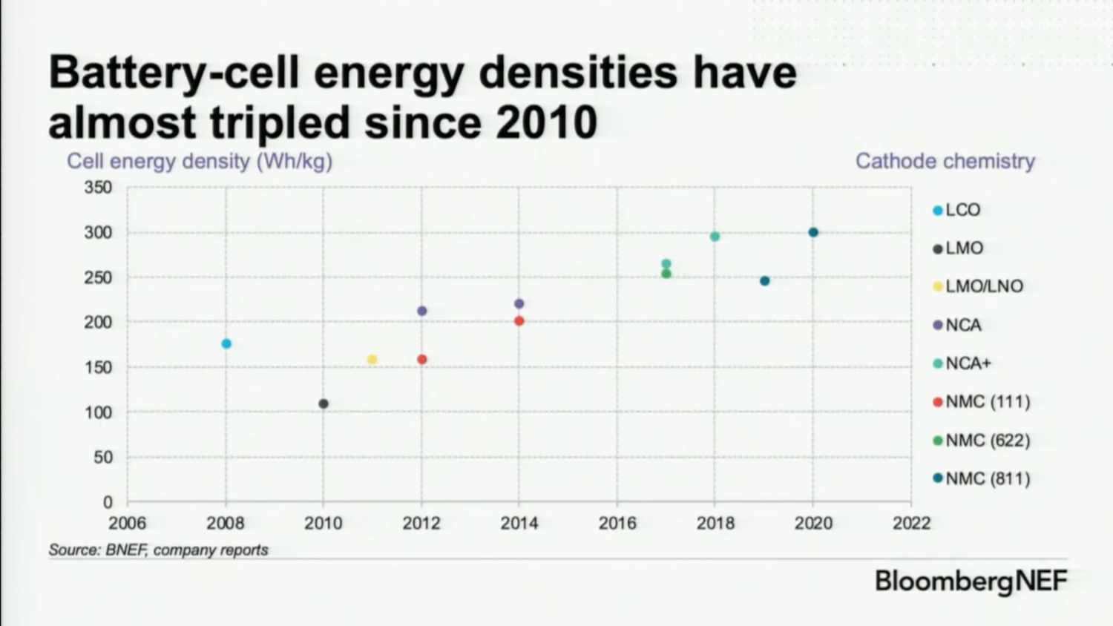
What new tech is coming?
6% / year

Slide 23
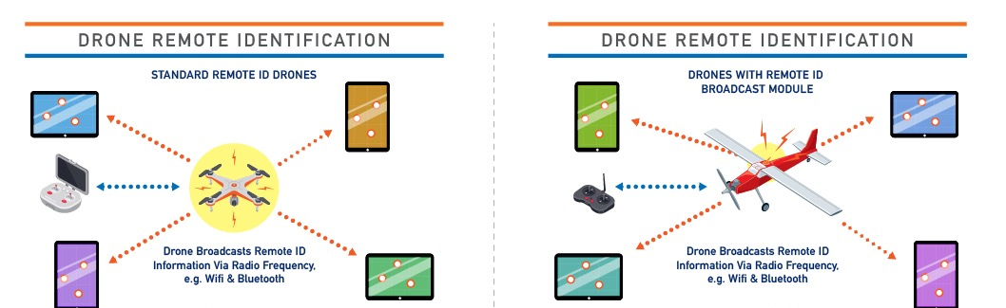
What new regs are coming?
December 2020 New FAA rules - Remote Identification, Operations Over People
RemoteID requirements come into effect on June 16th, 2023

Slide 24


What new regs are coming?
Restrictions on US export to Chinese drone companies.
“pose a significant risk of being or becoming involved in activities contrary to the national security or foreign policy interests of the United States.”

Slide 25
Outline
Why?
What?
How?
Why drones, why now?
What foundational concepts do I need to know to collect good drone data?
What changes are coming for drones in the near future?
What are common pitfalls of drone data, and how can I avoid them?
How to use R and Litchi to design robust drone data collection.

Slide 26
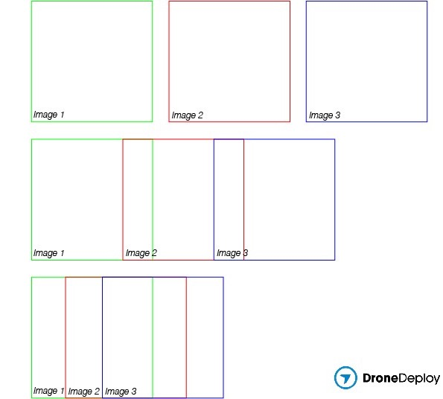
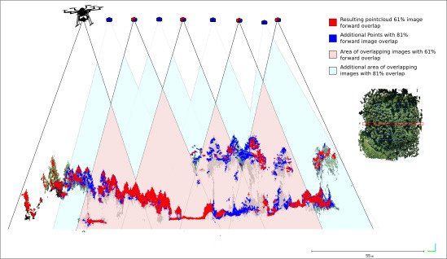
Planning pitfalls
Insufficient image overlap
Figure: Frey et al 2018

Slide 27
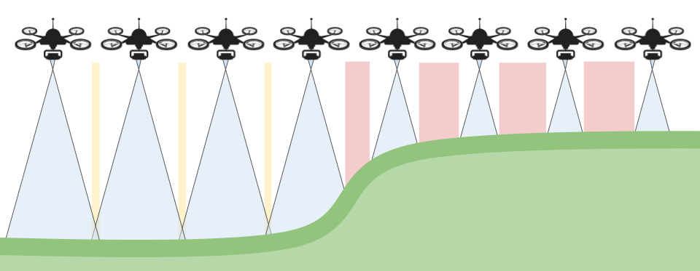
Planning pitfalls
Terrain following failure
Image: Propeller Aero

Slide 28
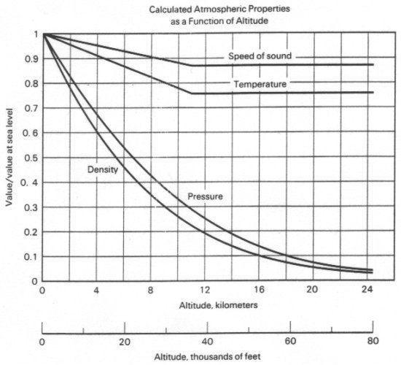
Planning pitfalls
Low battery safety margin
Mavic 2 sea level flight time:
35 minutes
flight time at 3000m:
~22 minutes
flight time at 3000m
with IR camera:
~18 minutes
Image: Aerospaceweb

Slide 29
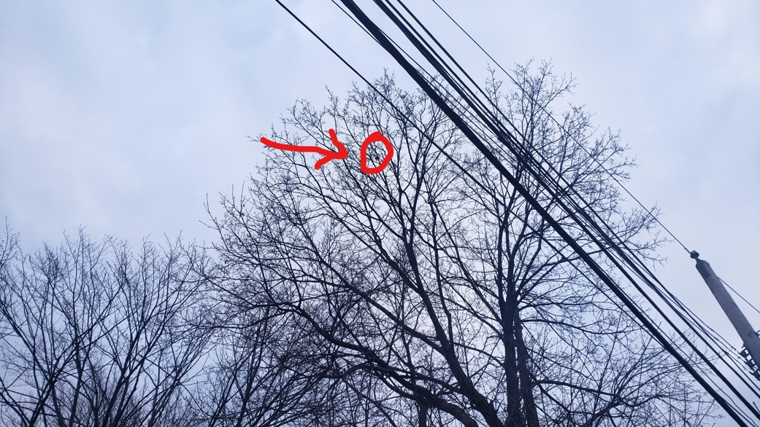
Planning pitfalls
Wires, trees, and other obstructions
Image: Reddit

Slide 30
Avoid planning pitfalls.
Plan flights for >75% overlap (>80% for forests or complex topography).
Plan flights that follow terrain if elevation changes are greater than ~10% of flight height.
Scout sites for obstruction and line-of-sight before planning.
Plan flights for <2/3 of battery life (less for repeat flights).

Slide 31
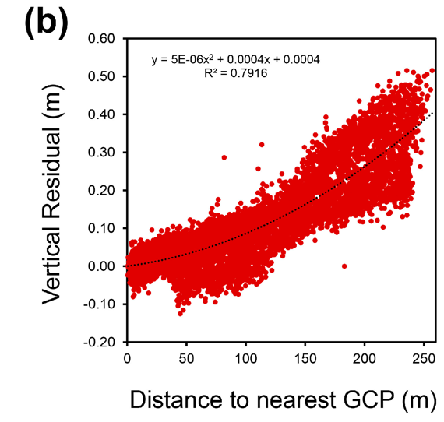
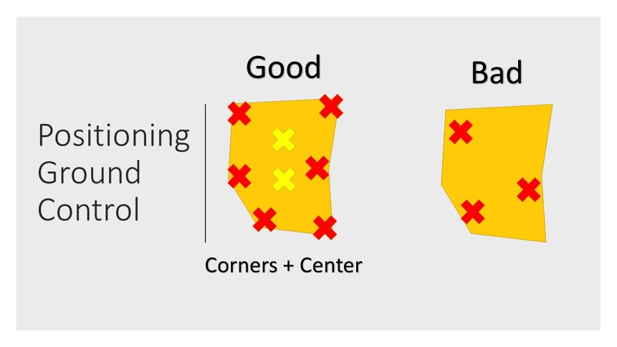
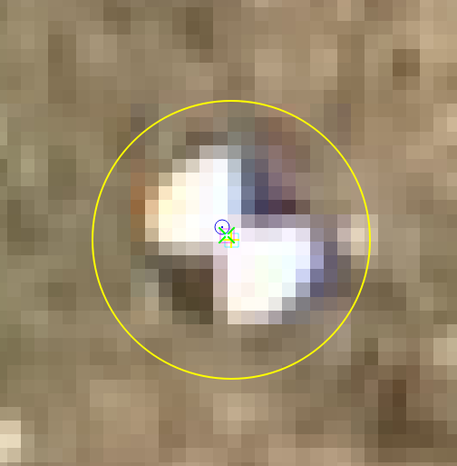
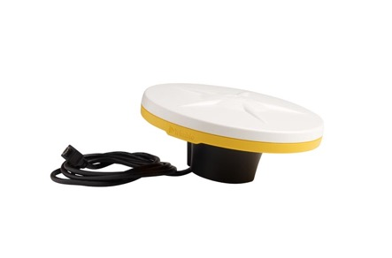
Execution pitfalls
Poor ground-control
Images: Trimble, Aerial Services, Tonkin & Midgeley 2016

Slide 32
Execution pitfalls
Bad illumination
Partly cloudy skies
Low sun angle
High sun angle

Slide 33
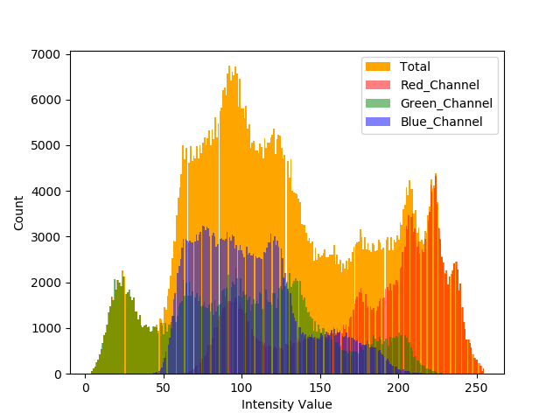
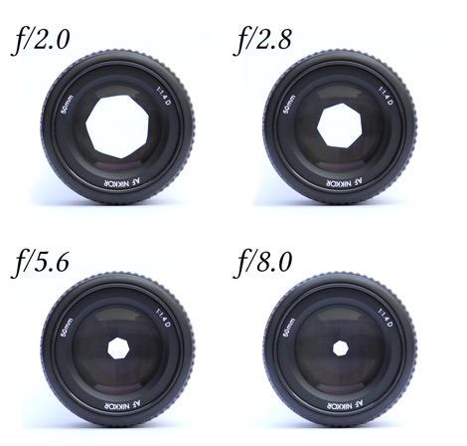
Execution pitfalls
Camera settings fail
Images: Mathanraj Sharma, KoeppiK

Slide 34

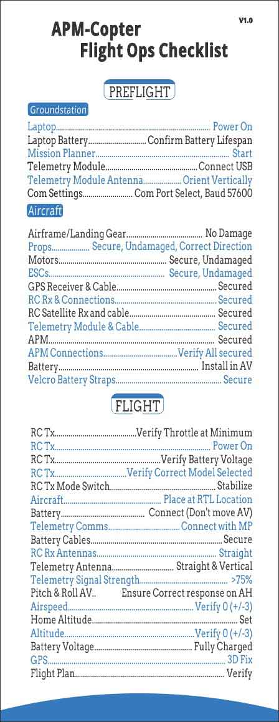
Execution pitfalls
Operator error
Images: Fox, ArduPilot

Slide 35
Avoid execution pitfalls
7-10 ground-control points per mission, geolocated to <30 cm accuracy, visible in imagery.
Avoid partly cloudy conditions, within 2 hours of solar noon.
Avoid 30-minutes of solar noon in summer.
Test and check camera settings before flight.
Checklists, checklists, checklists…

Slide 36

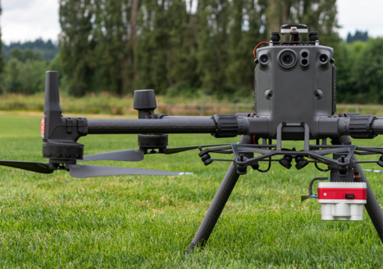
Do I want to do this myself?
2021 Drone Services:
Platform:
“Freemium” model, limited gratis missions for RMBL scientists
Application coming in February
Additional missions for a fee.
DJI m300 RTK* Micasense Altum
Multispectral + thermal
Images: RMBL, MicaSense

Slide 37
Outline
Why?
What?
How?
Why drones, why now?
What foundational concepts do I need to know to collect good drone data?
What changes are coming for drones in the near future?
What are common pitfalls of drone data, and how can I avoid them?
How to use R and Litchi to design robust drone data collection.

Slide 38
Demo: Designing a UAS mission in R and Litchi

Slide 39
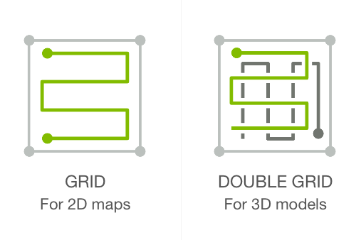
Flight types:
Image: Pix4D

Slide 40

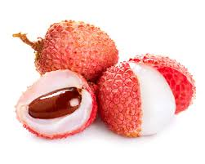
Flight planning software:
Litchi
Lychee
Images: Litchi, Britannica.com

Slide 41
Thanks!
Contact Me:
Ian Breckheimer
ikb@rmbl.org
Twitter, Github: @ibreckhe

Slide 42
References
Petrasova, A., Mitasova, H., Petras, V., & Jeziorska, J. (2017). Fusion of high-resolution DEMs for water flow modeling. Open Geospatial Data, Software and Standards, 2(1), 1-8.
Sperlich, Maximillian, et al. "Potential of unmanned aerial vehicle based photogrammetric point clouds for automatic single tree detection." Gemeinsame Tagung (2014): 1-6.
Tonkin, T. N., & Midgley, N. G. (2016). Ground-control networks for image based surface reconstruction: An investigation of optimum survey designs using UAV derived imagery and structure-from-motion photogrammetry. Remote Sensing, 8(9), 786.
Tmušić, G., Manfreda, S., Aasen, H., James, M. R., Gonçalves, G., Ben-Dor, E., ... & McCabe, M. F. (2020). Current practices in UAS-based environmental monitoring. Remote Sensing, 12(6), 1001.
Frey, J., Kovach, K., Stemmler, S., & Koch, B. (2018). UAV photogrammetry of forests as a vulnerable process. A sensitivity analysis for a structure from motion RGB-image pipeline. Remote Sensing, 10(6), 912.

